Slide 1
Logic & FindPatterns
Notes:
This slide should feature the main topic title as well as any slightly more specific subtitle that may help identify the topic when displayed to students.
For example:
Title: DVT ActiveX Controls
Subtitle: How to build a DVT enabled ActiveX application.

Slide 2
Mathematical Functions
Mathematical functions and operators include:
  Logic: And, If, InRange, Not, Or, BitAnd
  Lookup: Choose, CountErr, Switch
  Math: Abs, Exp, Mod, Rand, Round, Sqrt
  Statistics: Max, Mean, Min, Sdev
  Trigonometry: Cos, Acos, Radians, Sin, Tan
Ultimate goal: to make a decision about an object being inspected using the information returned by the vision tools
Must proceed from measurements to decision
Four examples:
  If
  And
  InRange
  Not

Slide 3
Decisions: If
If (condition, true_value, false_value)
If condition is TRUE, cell gets true_value
If condition is FALSE, cell gets false_value
Note that when functions evaluate numbers:
0 = FALSE
anything other number = TRUE (for example -5, -345, 1, 34 are all TRUE)
Example:
A1 = 200
A2= If (A1<128, “GOOD”, ”BAD”)
A2 contains string of characters “BAD”

Slide 4
Decisions: And
And (condition0, condition1, condition2, …)
Returns TRUE (1) if all conditions are TRUE, otherwise returns FALSE (0)
Note: FALSE = 0
TRUE = anything other than 0, for example -5, -2, 1, 3, -245 are all considered TRUE
Example:
A1=23, B1=10, C1= 22
D1 = If ( And(A1>B1, A1<C1), 1, -1 )
D1 contains -1

Slide 5
Decisions: InRange
InRange (value, min_value, max_value)
Returns TRUE (1) if value is greater than min_value AND less than max_value, otherwise returns FALSE (0)
Example:
A1=23, B1=10, C1= 22
F1 = InRange (C1, B1, A1)
F1 contains 1

Slide 6
Decisions: Not
Not(condition)
Returns opposite of condition
Example:
B7=92
D1 = If (Not(B7>95), 0, 1)
D1 contains 0

Slide 7
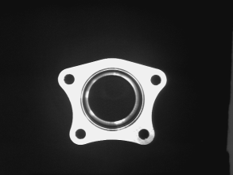
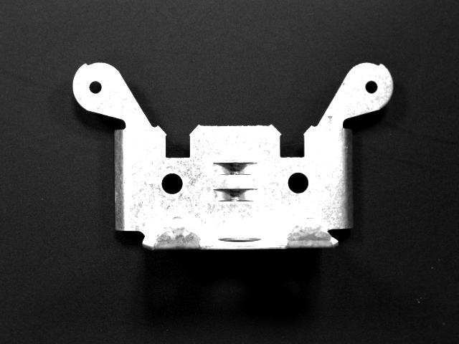
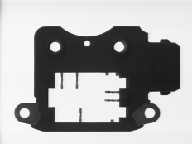
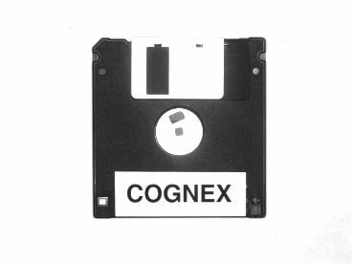
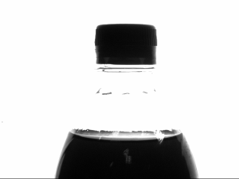
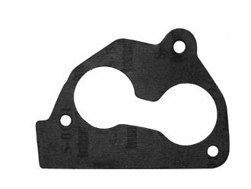
FindPatterns Applications

Slide 8

FindPatterns Applications
Determine (x, y) part location
Determine orientation
Determine scale variations within +/-10%
(x, y)
angle
scale

Slide 9
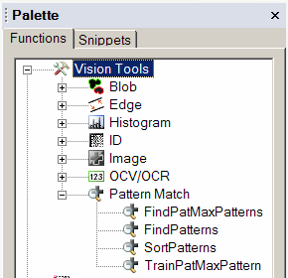
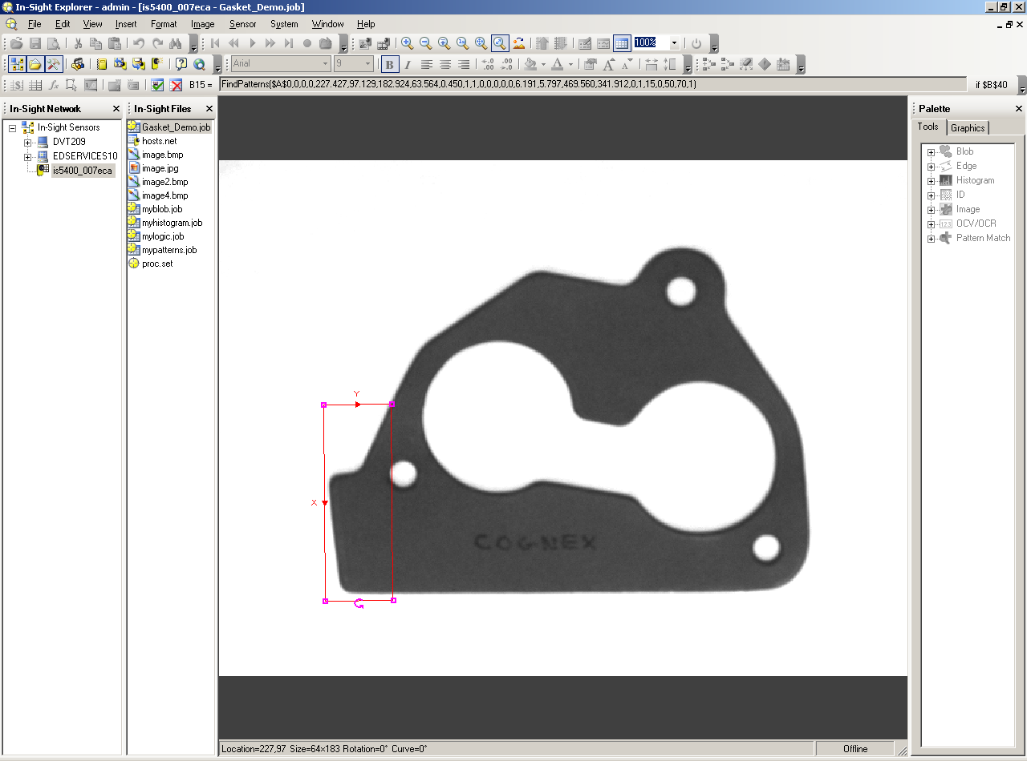
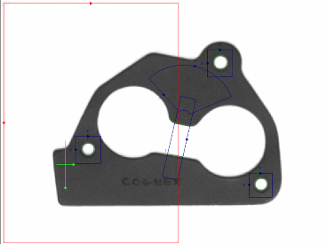
FindPatterns
Pattern Match
  Train a model part, followed by model part searching at run time
  FindPatterns & PatMax®
Model Region
Find Region

Slide 10
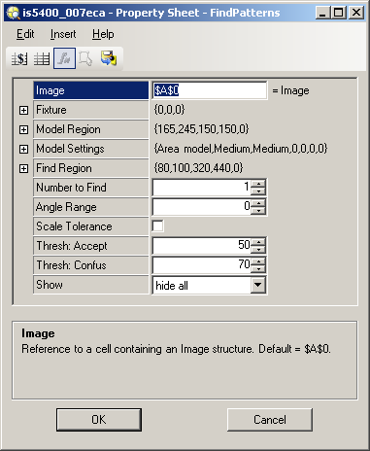
FindPatterns Property Sheet
Reference to target image cell
Where tool should fixture itself
Region specifying model features
Advanced settings
Region specifying searching area
How many instances to look for
+/- rotation tolerance
Enable +/-10% size variations
Minimum score needed for match
Minimum score needed for speed match
Graphic options for display

Slide 11
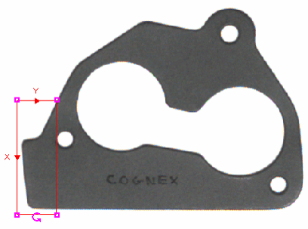
Setting a Region
Model region and
Find region graphics
(red lines) can;
move, resize, and
rotate a region.
Mode depends on where you place cursor
resize
move
Model graphics
Find graphics
rotate
Note: the entire Model region must be within the Find region to be found

Slide 12
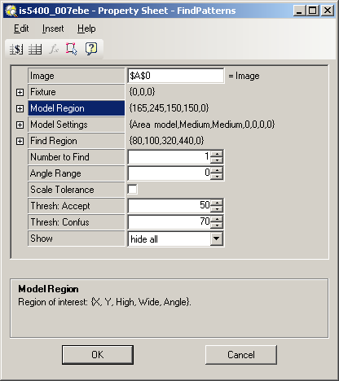

How To Set Model or Find Region
To set the model region, follow these steps:
Select Model Region from property sheet.
Click (edit graphics).
Use graphics (Red Lines) to select features for the model on the image.
Click green check to OK selection.

Slide 13
FindPatterns: Model Settings: Area Model
Uses pixel values in region
Normalized correlation search
Use when all pixels values in region should match model

Slide 14
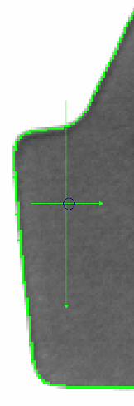
FindPatterns: Model Settings: Edge Model
Look for green outline of boundary
Creates a geometric model of just the edges
Use when edges are what is important, not pixel grayscale value in region

Slide 15
FindPatterns: Model Type
Area Model may be better when:
Model Region is small
No well-defined edges
Speed is critical
Edge Model may be better when:
Back lighting
Non-linear lighting changes, such as shiny metal parts
Significant changes in focus or background

Slide 16
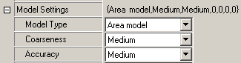
FindPatterns: Coarseness
Specifies size of smallest features in trained model
Fine - smallest features approximately 4 pixels in size.
Medium - smallest features approximately 4 to 8 pixels in size.
Coarse - smallest features larger than 8 pixels in size.
Notes:
For Edge models, Coarseness and Accuracy together determine the size of features to look for and the tolerance for the edge locations in training. The following table shows the translation between these two parameters and the minimum feature size and tolerance for edge movement in the trained pattern.
Min Feature - the minimum size (in pixels) of the dark and light region on each side of an edge for that edge to be included in the model. If the feature size is small, all of the really fine features in the pattern will be included in the model, but too much noise might be included for a very coarse model. If the feature size is coarse, the noise will be ignored, but so will the very fine features is they exist.
Edge Tolerance - the maximum amount that an edge can move (+ or - in pixels) from the trained location and still give a strong response. If this tolerance is small, the pattern can be located more accurately, but small steps must be taken during run time to ensure that the pattern is found, resulting in a slower search. If this tolerance is large, the pattern can't be located as accurately, but larger steps can be taken during run time, resulting in a faster search.
Coarseness Accuracy Min Feature (pixels) Edge Tolerance (pixels)
----------------- ------------- ---------------------------- ---------------------------------
Fine Accurate 1-2 0.5-1.5
Fine Medium 2-4 0.5-2
Fine Fast 4-6 1-2.5
Medium Accurate 4-6 0.5-2.5
Medium Medium 6-8 1-3
Medium Fast 8-10 1.5-4
Coarse Accurate 10-12 0.5-3
Coarse Medium 12-14 1-4
Coarse Fast 14-16 2-6
For Area models, the Edge Tolerance numbers derived from Coarseness and Accuracy are stored during training so that coarser or finer searching can be done, resulting in a small difference in search speed.
For both types of models, an Accuracy setting of Fast causes the run-time to evaluate fewer similar looking possible results than an Accuracy setting of Accurate. This also results in a small speed difference.

Slide 17
FindPatterns: Accuracy
Specifies the tradeoff between accuracy/reliability and execution speed.
Accurate - higher accuracy/reliability & slower execution speed
Medium - moderate accuracy & speed
Fast - lower accuracy/reliability and faster execution
Notes:
For Edge models, Coarseness and Accuracy together determine the size of features to look for and the tolerance for the edge locations in training. The following table shows the translation between these two parameters and the minimum feature size and tolerance for edge movement in the trained pattern.
Min Feature - the minimum size (in pixels) of the dark and light region on each side of an edge for that edge to be included in the model. If the feature size is small, all of the really fine features in the pattern will be included in the model, but too much noise might be included for a very coarse model. If the feature size is coarse, the noise will be ignored, but so will the very fine features is they exist.
Edge Tolerance - the maximum amount that an edge can move (+ or - in pixels) from the trained location and still give a strong response. If this tolerance is small, the pattern can be located more accurately, but small steps must be taken during run time to ensure that the pattern is found, resulting in a slower search. If this tolerance is large, the pattern can't be located as accurately, but larger steps can be taken during run time, resulting in a faster search.
Coarseness Accuracy Min Feature (pixels) Edge Tolerance (pixels)
----------------- ------------- ---------------------------- ---------------------------------
Fine Accurate 1-2 0.5-1.5
Fine Medium 2-4 0.5-2
Fine Fast 4-6 1-2.5
Medium Accurate 4-6 0.5-2.5
Medium Medium 6-8 1-3
Medium Fast 8-10 1.5-4
Coarse Accurate 10-12 0.5-3
Coarse Medium 12-14 1-4
Coarse Fast 14-16 2-6
For Area models, the Edge Tolerance numbers derived from Coarseness and Accuracy are stored during training so that coarser or finer searching can be done, resulting in a small difference in search speed.
For both types of models, an Accuracy setting of Fast causes the run-time to evaluate fewer similar looking possible results than an Accuracy setting of Accurate. This also results in a small speed difference.

Slide 18



Coarseness & Accuracy Examples
Coarseness: Coarse
Accuracy: Fast
Coarseness: Medium
Accuracy: Medium
Coarseness: Fine
Accuracy: Accurate
Notes:
For Edge models, Coarseness and Accuracy together determine the size of features to look for and the tolerance for the edge locations in training. The following table shows the translation between these two parameters and the minimum feature size and tolerance for edge movement in the trained pattern.
Min Feature - the minimum size (in pixels) of the dark and light region on each side of an edge for that edge to be included in the model. If the feature size is small, all of the really fine features in the pattern will be included in the model, but too much noise might be included for a very coarse model. If the feature size is coarse, the noise will be ignored, but so will the very fine features is they exist.
Edge Tolerance - the maximum amount that an edge can move (+ or - in pixels) from the trained location and still give a strong response. If this tolerance is small, the pattern can be located more accurately, but small steps must be taken during run time to ensure that the pattern is found, resulting in a slower search. If this tolerance is large, the pattern can't be located as accurately, but larger steps can be taken during run time, resulting in a faster search.
Coarseness Accuracy Min Feature (pixels) Edge Tolerance (pixels)
----------------- ------------- ---------------------------- ---------------------------------
Fine Accurate 1-2 0.5-1.5
Fine Medium 2-4 0.5-2
Fine Fast 4-6 1-2.5
Medium Accurate 4-6 0.5-2.5
Medium Medium 6-8 1-3
Medium Fast 8-10 1.5-4
Coarse Accurate 10-12 0.5-3
Coarse Medium 12-14 1-4
Coarse Fast 14-16 2-6
For Area models, the Edge Tolerance numbers derived from Coarseness and Accuracy are stored during training so that coarser or finer searching can be done, resulting in a small difference in search speed.
For both types of models, an Accuracy setting of Fast causes the run-time to evaluate fewer similar looking possible results than an Accuracy setting of Accurate. This also results in a small speed difference.

Slide 19

Accept & Confusion Thresholds
Phase 1:
  Uses lower resolution
  Fast
  Ignores candidates below Accept threshold
  Considers candidates above Confusion threshold to be matches
Accept (50)
Confusion (70)
0
100
MAYBE
(Phase 2 only)
NO
YES

Slide 20
Accept & Confusion Thresholds
Phase 2:
  Only runs if Phase 1 returns insufficient number of valid results
  Uses full resolution
  Evaluates only those candidates that scored between Accept and Confusion thresholds
Accept (50)
Confusion (70)
0
100
MAYBE
(Phase 2 only)
NO
YES

Slide 21
Accept & Confusion Thresholds
Accept (70)
Confusion (70)
0
100
Fastest
NO
YES
No MAYBE Zone
Accept (50)
Confusion (100)
Most Thorough
0
100
NO
Large MAYBE Zone

Slide 22

FindPatterns: Show Parameter
Dictates what/when graphics are displayed for a function
Input graphics are what you specify
For FindPatterns: Model and Find regions
Result graphics are what graphics the tool function displays
For FindPatterns: the location cross
Hide all: Find Region & cross are shown, but only when FindPatterns is active cell and system is Offline
Result graphics only: cross is always shown
Input and result graphics: the Find Region and cross are always shown

Slide 23
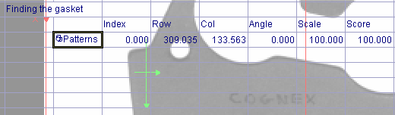
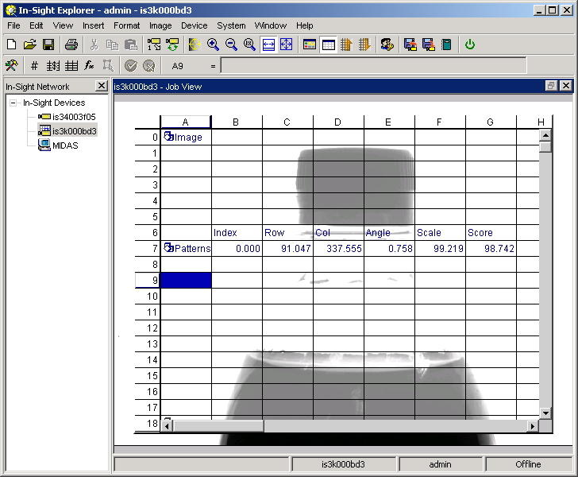
FindPatterns: Results
Cross
Indicates center of model found
Tool Structure
Holds all result information returned by the tool
Notes:
WHAT IF?
COMMON
ERROR:
FORGET TO HIT OK

Slide 24
Structures
Structure contains multiple values returned by a function, such as image or features extracted from image
Example: FindPatterns structure includes the row, column, & angle where match was found

Slide 25
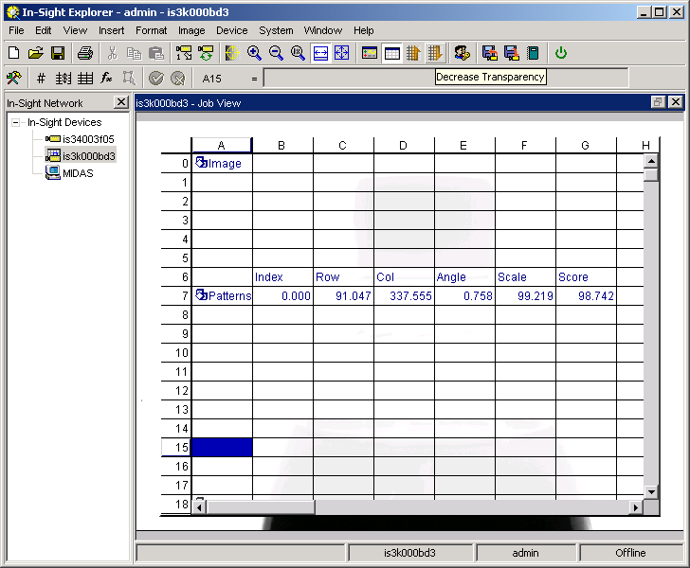
FindPatterns: Auto-Inserted Functions
structure
GetRow($A$2,B2)
GetCol($A$2,B2)
GetAngle($A$2,B2)
GetScale($A$2,B2)
GetScore($A$2,B2)

Slide 26
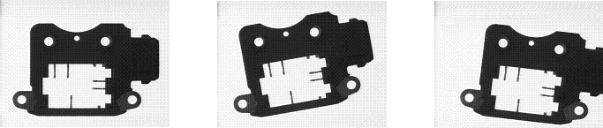
Intérêt du recalage
Dans les applications où la position de la pièce change, il est nécéssaire que les outils se replacent automatiquement sur la pièce
    Cela permet de fiabiliser le contrôle
    Les régions d’intérêt des autres outils peuvent être plus petites, d’où un gain en temps de traitement
Notes:
Diapositive <number>
Notes :
_________________________________________________________________________________
_________________________________________________________________________________
_________________________________________________________________________________
_________________________________________________________________________________
_________________________________________________________________________________
_________________________________________________________________________________
_________________________________________________________________________________

Slide 27

Principe du recalage
Utiliser les coordonnées d’un ou de plusieurs outils pour retrouver la pièce en X, Y, Angle
Cet outil est appelé outil de recalage
On référence ces valeurs dans les fonctions à replacer automatiquement
Notes:
Diapositive <number>
Notes :
_________________________________________________________________________________
_________________________________________________________________________________
_________________________________________________________________________________
_________________________________________________________________________________
_________________________________________________________________________________
_________________________________________________________________________________
_________________________________________________________________________________

Slide 28
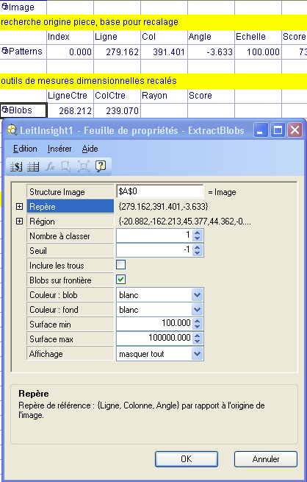
Recaler un outil de vision
Notes:
Diapositive <number>
1) Création d’un outil de recalage :
Dans cet exemple, on utilise les résultats d’un premier outil, placé en cellule A5 pour recaler un second outil placé en cellule A11.
Le premier (en A5) est un PatFind®. Son but est de localiser la pièce (voir “créer un PatFind”).
2) Création d’un outil recalé :
Le second outil (en A11) a pour but de faire un contrôle de présence / absence du trou inférieur gauche de la pièce. Il s’agit d’un autre PatFind®. Pour fonctionner, cet outil doit se replacer automatiquement sur la pièce. Il doit donc récupérer les coordonnées de celle-ci.
A sa création, on sélectionne son paramètre Repère(X, Y, thêta).

